Slide 1

The tech devils
Sprint demo 2

Slide 2


Table of contents
Description
Implementation
Kitchen system
Door/living room system
Administrator system
questions

Slide 3
description
Basic description of system
Amount of Arduino’s
Sensors
Extra’s
Phone application(RFID)
Phone communication(custom lighting)
Bathroom/automatic washing machine

Slide 4
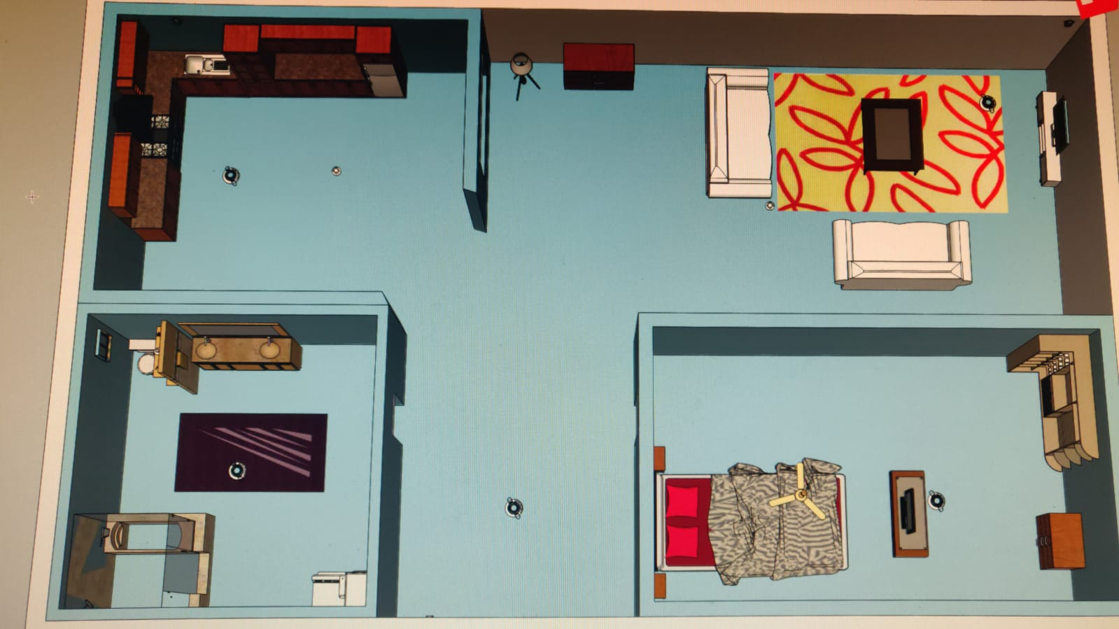
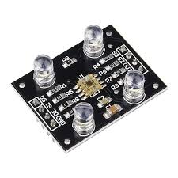
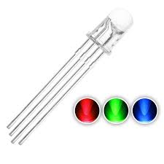
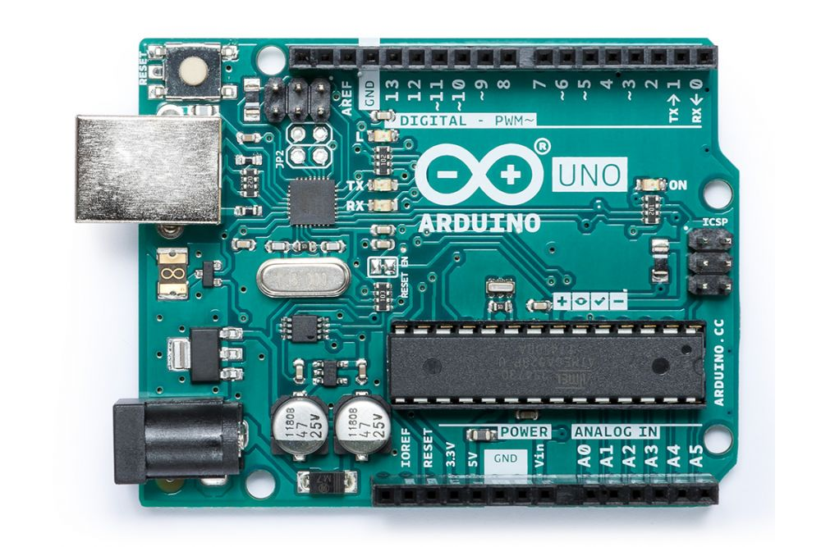
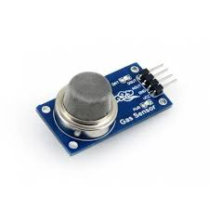
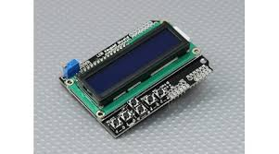
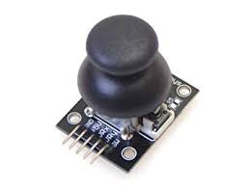
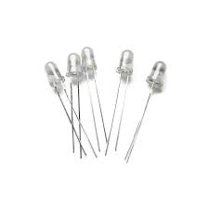
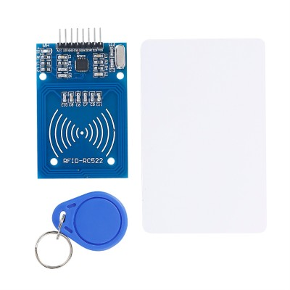


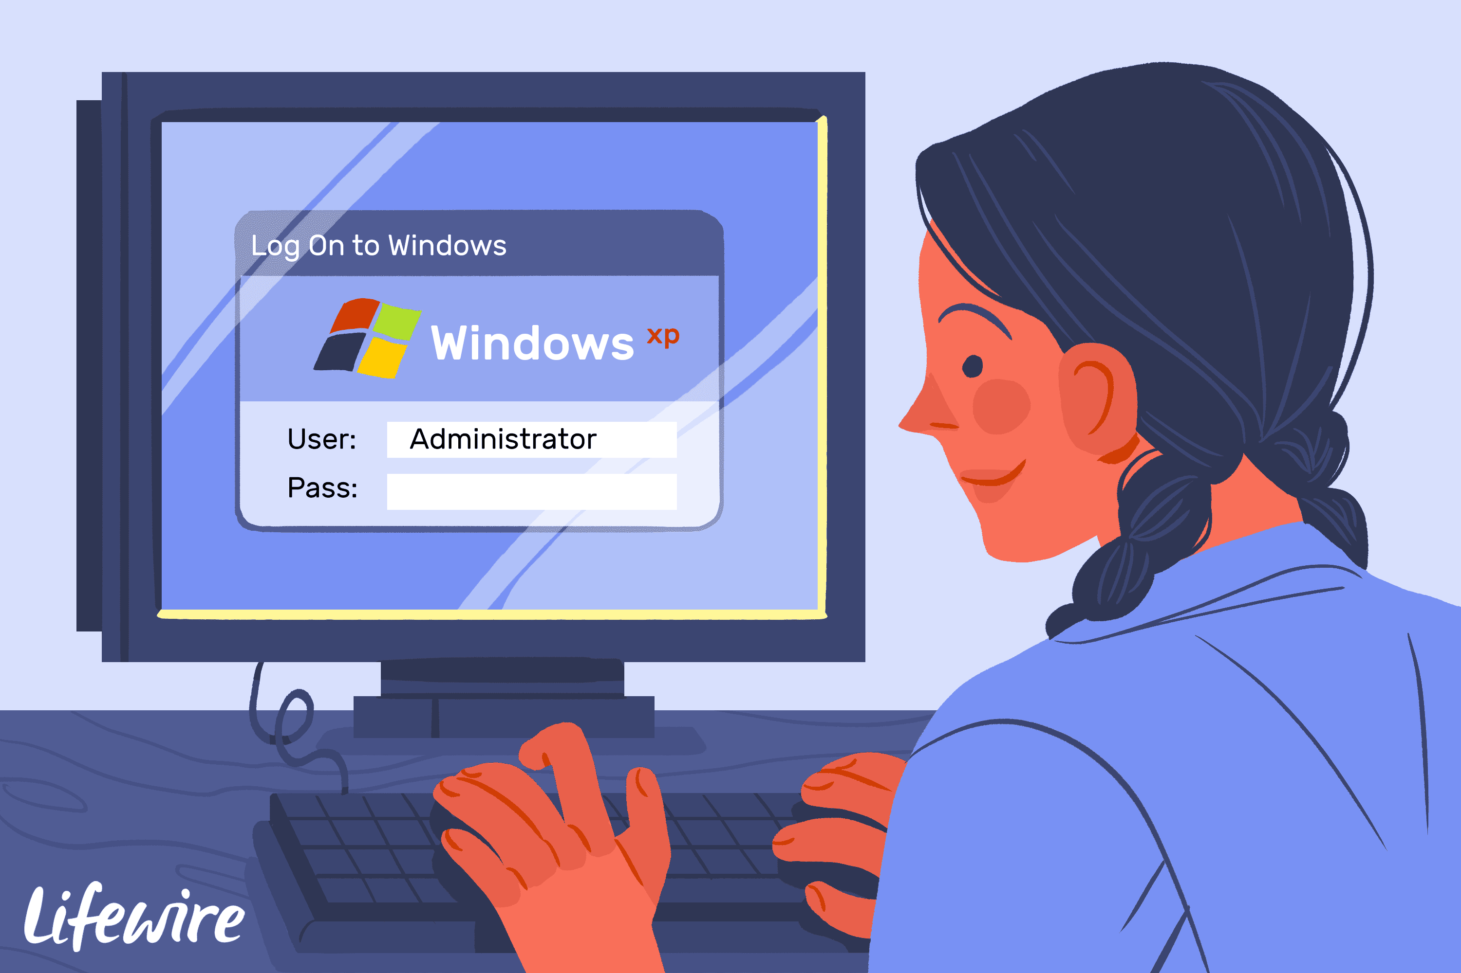
implementation
Kitchen system
Bedroom system
Door system(RFID)
Living room system
Extra:
Bathroom system

Slide 5
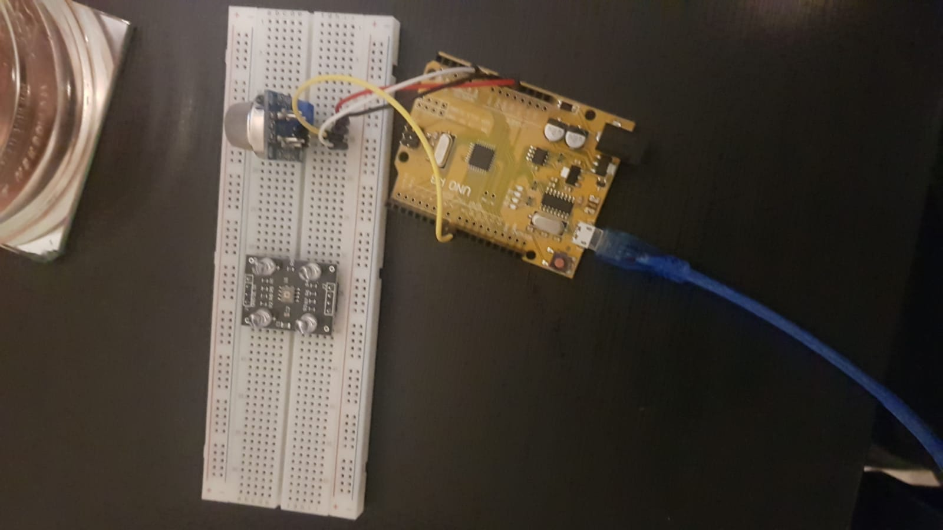
Kitchen system

Slide 6
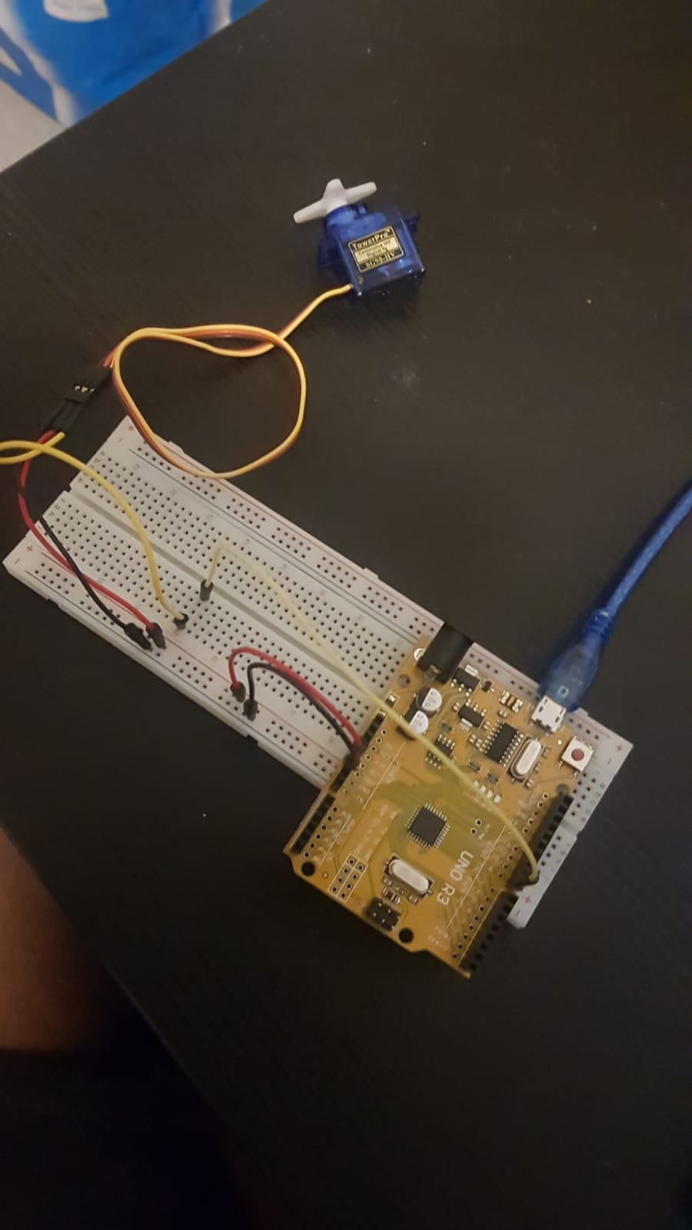
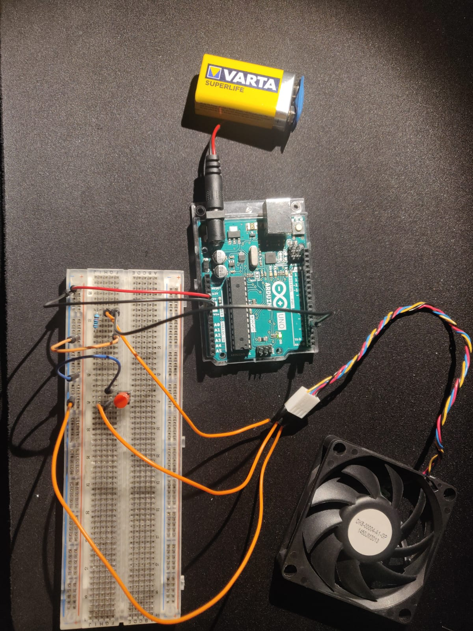
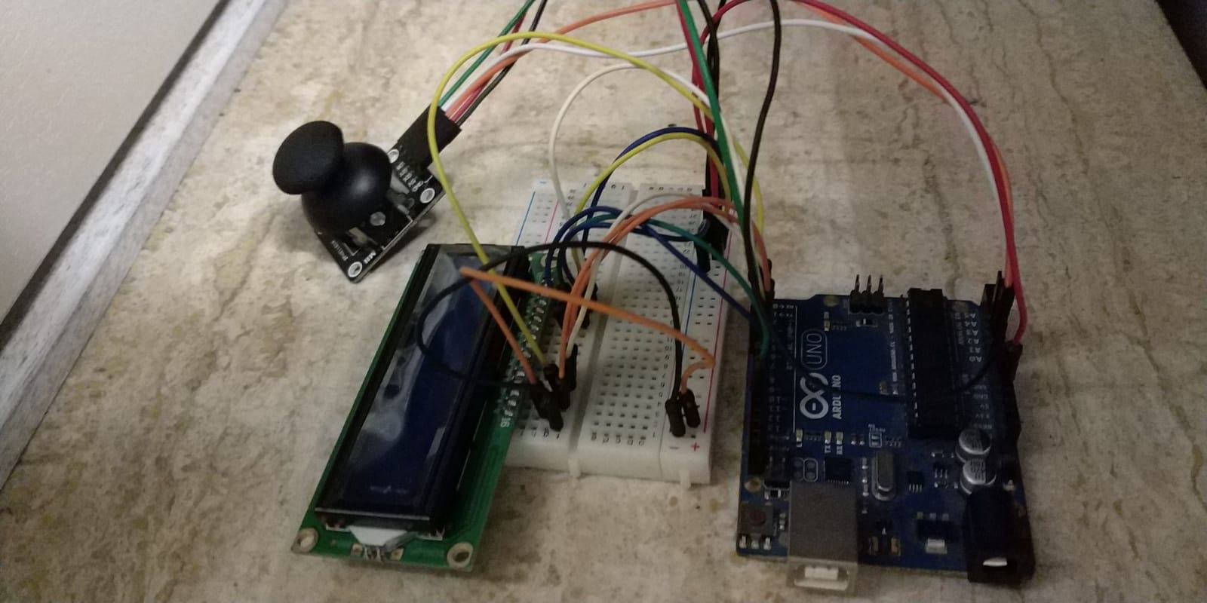
Bedroom/living room system

Slide 7
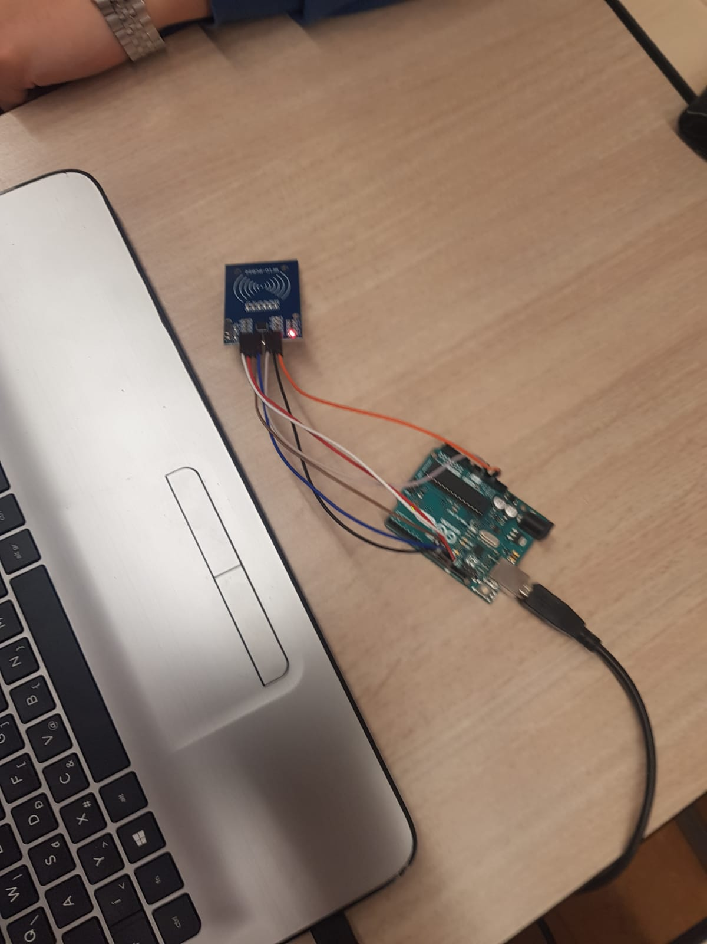
Door system

Slide 8
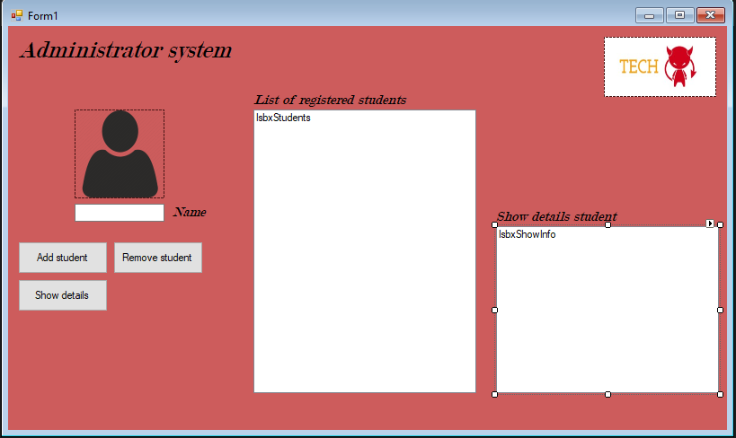
Administrator system

Slide 9

Questions?

